Slide 1
A tutorial explaining by example Tryton installation & usage for first time administrators & users of the system - Usage : Purchase
Tryton By Example
Github - https://github.com/clixwise/tryton-by-example Version of documentation : 01.01 Dated 28-Apr-21 Version of Tryton : 5.8 Verified for execution on : Windows 10 & Powershell 7 Documentation : GNU GPL Author : Marc Rottiers

Slide 2
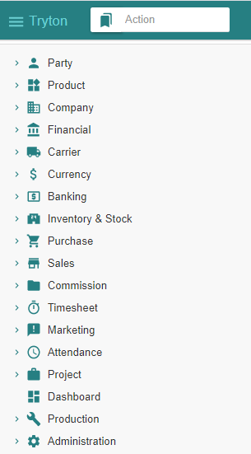
Table of Contents

Slide 3
TOC
Supplier
Product
Inventory & Stock
Purchase
State Change Template
Supplier Purchase
Supplier Shipment
Supplier Invoice
Supplier Payment
Activating Supplier-related modules
Activating Product-related modules
Activating Stock-related modules
Activating Purchase-related modules
The entities that record changes when performing “Purchase” related operations
Recording a Purchase
Recording a Shipment
Emitting an Invoice
Paying an Invoice

Slide 4
Supplier

Slide 5
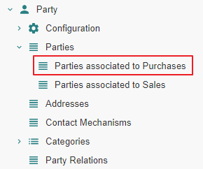
Motivation
Suppliers are named « Parties associated to Purchases ». We name them hereafter « Supplier » for commodity.
Suppliers are in fact party entity roles : any party becomes a supplier as soon as one or more purchases are linked to it.
Creation : a supplier can be initially defined by creating an instance using the Menu Tree Item « Parties » or « Parties associated to Purchases ».
Access : as long as no purchase is linked to that party, it is not recognized as a supplier and will only be accessible using the Menu Tree Item « Parties ».
Note finally that « Party » modules have been activated as explained in the previous document « Basic Functionalities ».

Slide 6
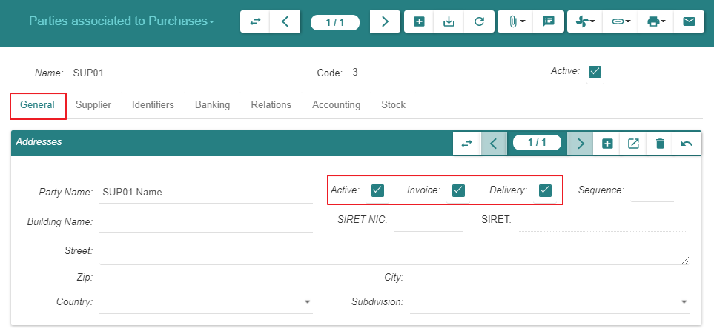
Create

Slide 7
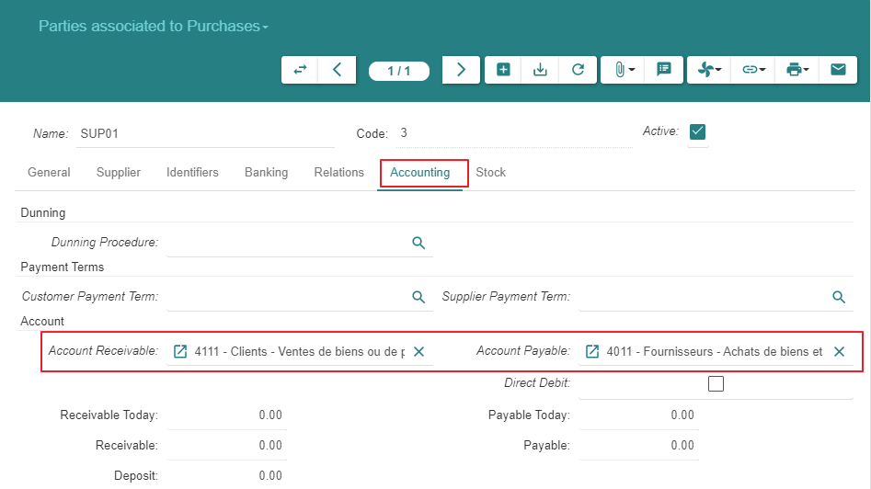
Create

Slide 8
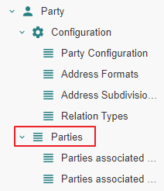
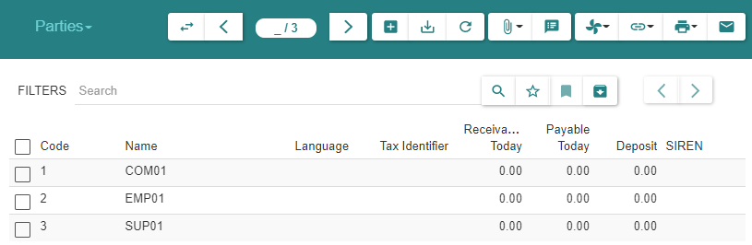
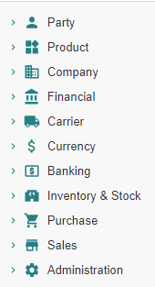
Summary
As explained under « Motivation », the supplier always appears in the list « Parties » above
As long as there are no purchases linked to the supplier, it is absent from « Parties associated to Purchases »
When at least one purchase exists, the supplier will appear in both lists : « Parties » and « Parties associated to Purchases »

Slide 9
Product

Slide 10
Motivation
We activate all inactive « Product » related modules
We define a « Product » and its « Variant »

Slide 11
Module Activation

Slide 12
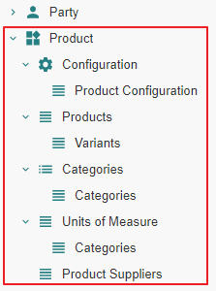
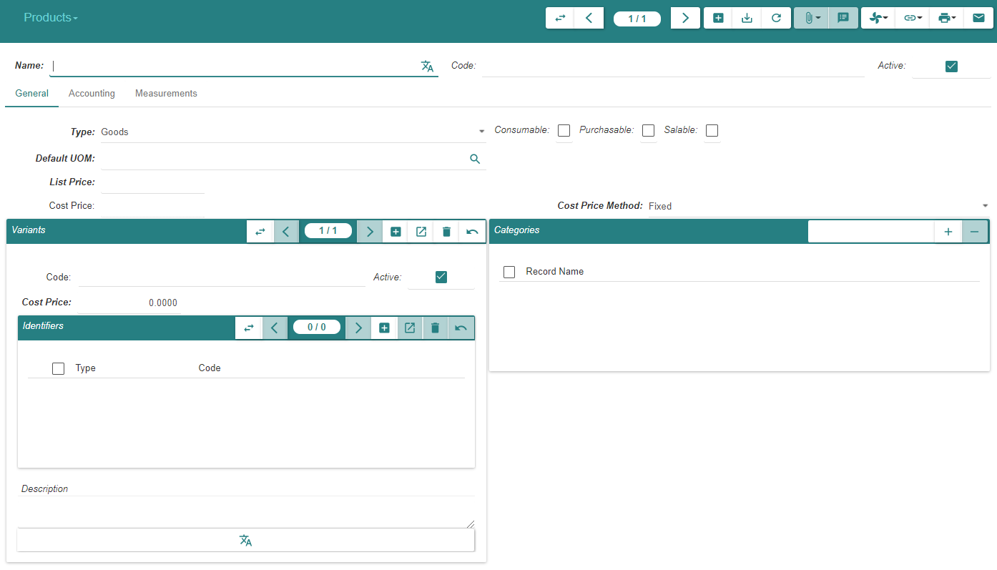
State « Ante »

Slide 13
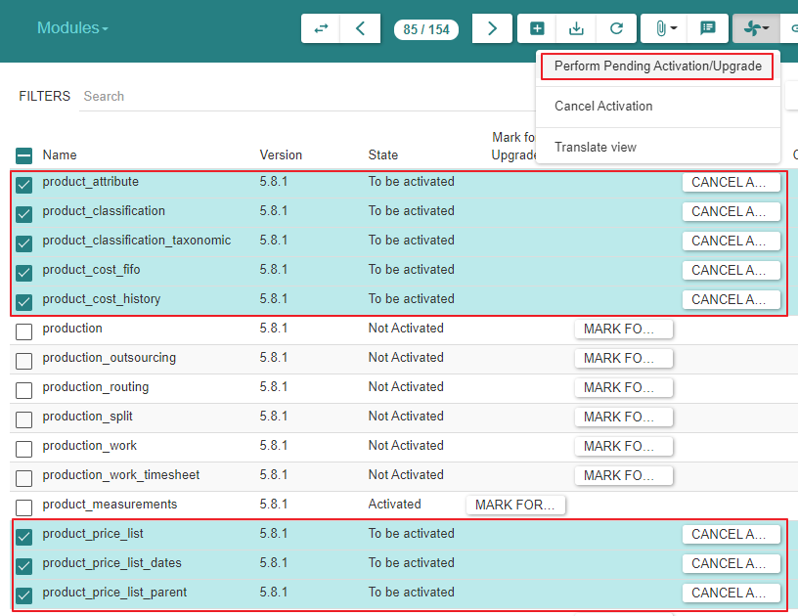
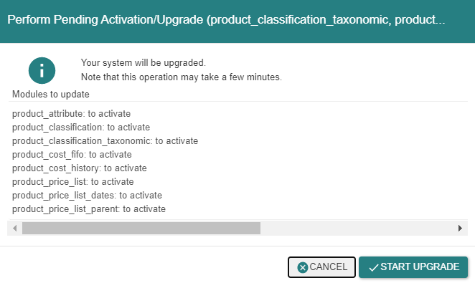
Module Activation

Slide 14
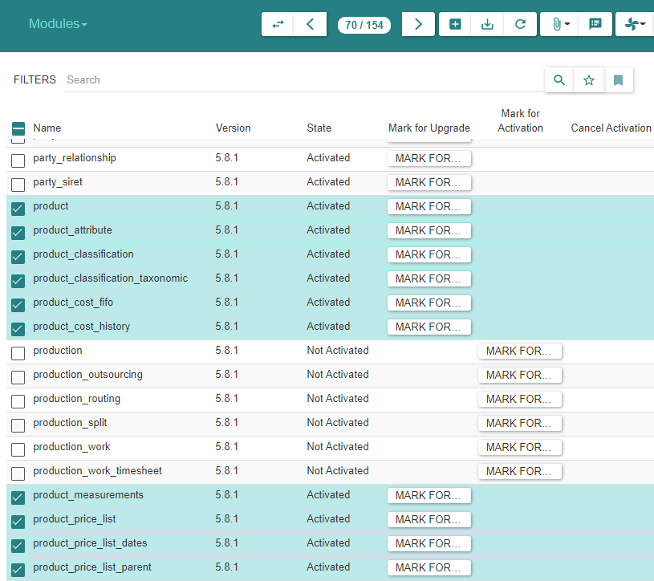
Module Activation

Slide 15
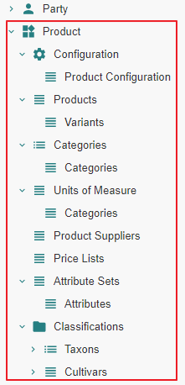
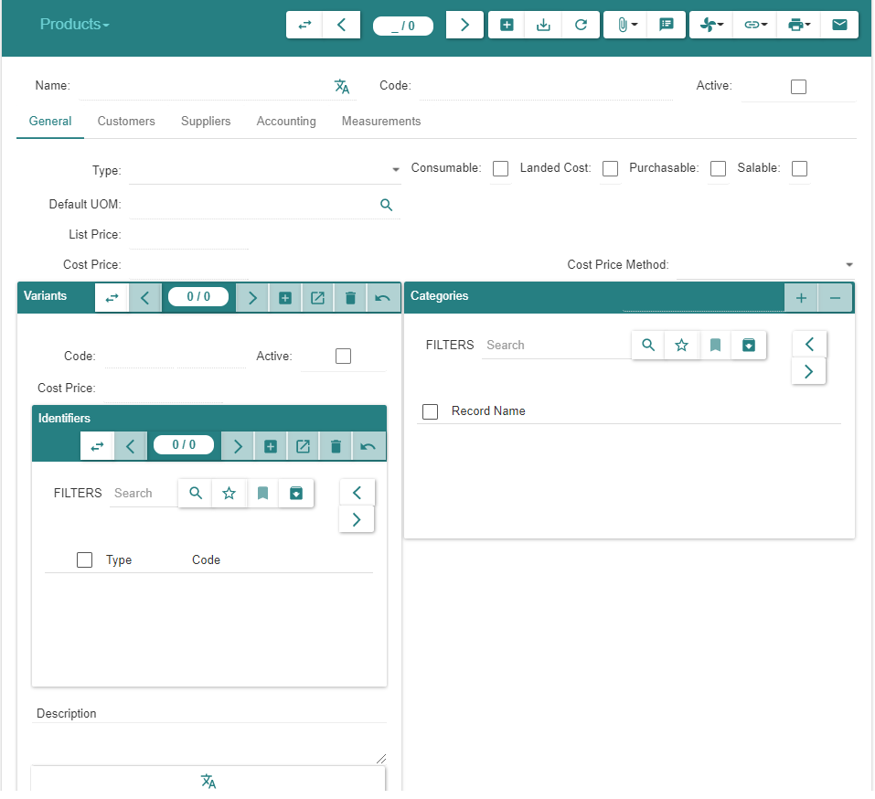
State « Post »

Slide 16
Product & Variant Creation

Slide 17
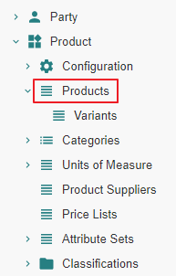
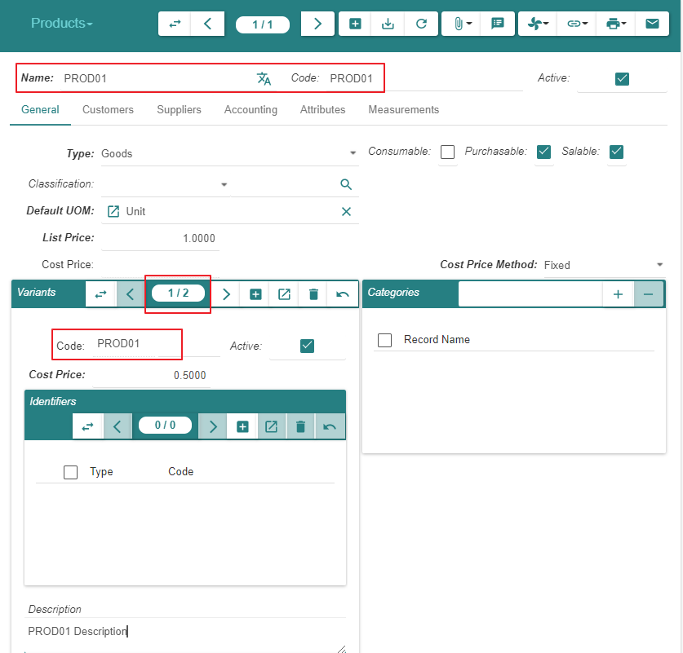
Create « Product PROD01 » & « Variant VA01 »

Slide 18
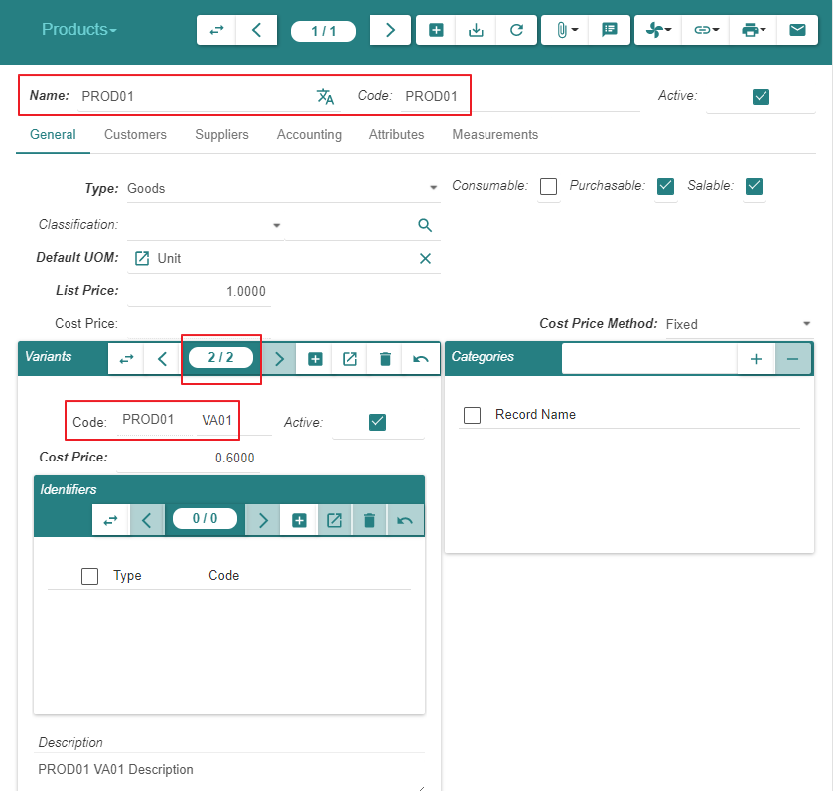
Create « Product PROD01 » & « Variant VA01 »

Slide 19
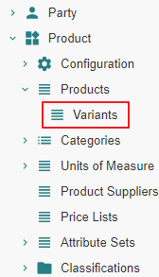
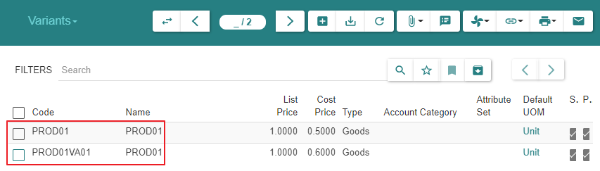
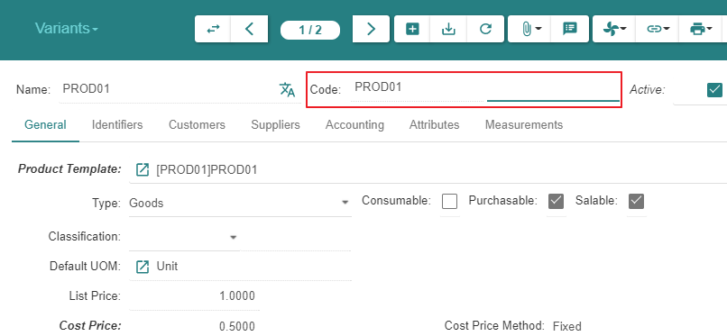
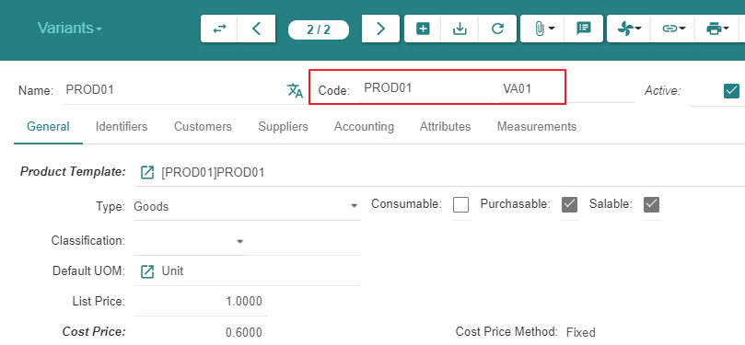
Display « Variants »

Slide 20
Inventory & Stock

Slide 21
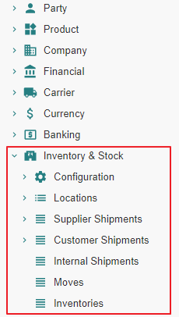
Motivation
We activate all inactive « Inventory & Stock » related modules

Slide 22
Module Activation

Slide 23
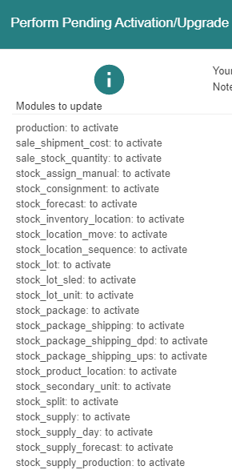
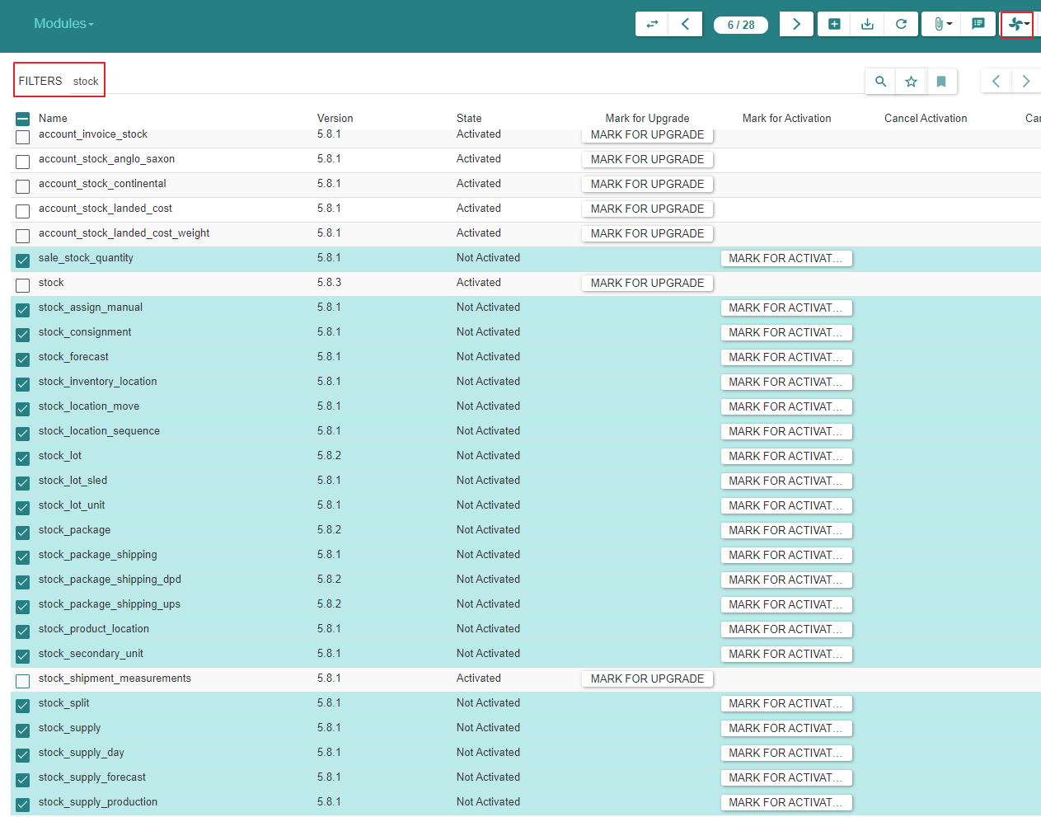
Module Activation

Slide 24
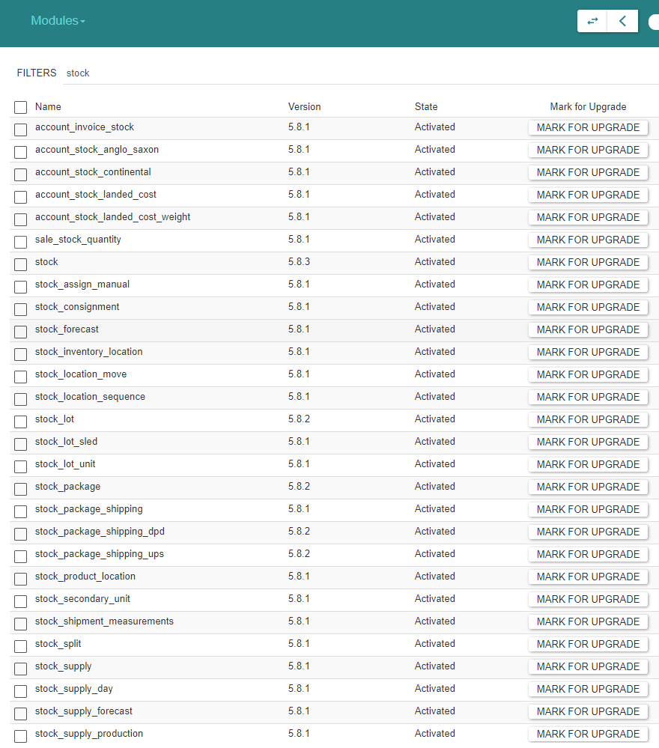
Module Activation

Slide 25
Purchase

Slide 26
Module Activation

Slide 27
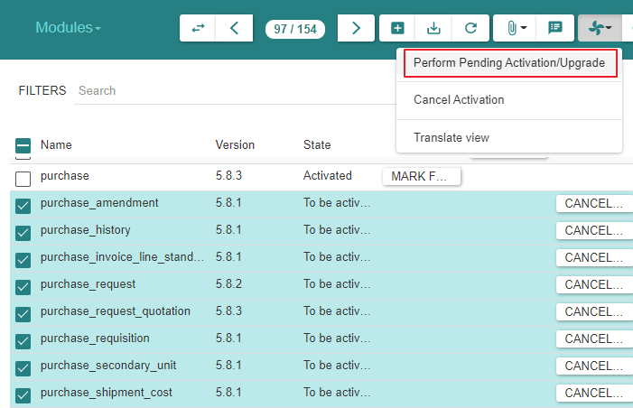
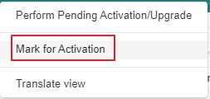
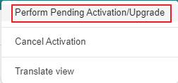
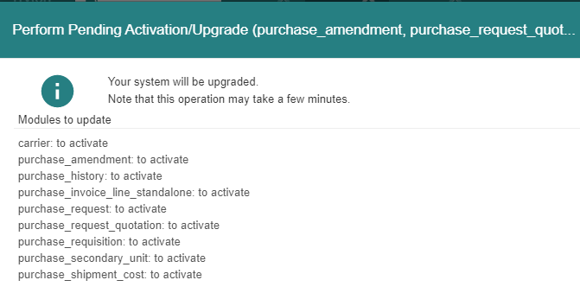
Module Activation

Slide 28
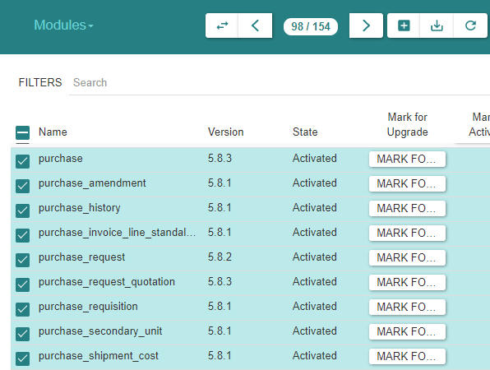
Module Activation

Slide 29
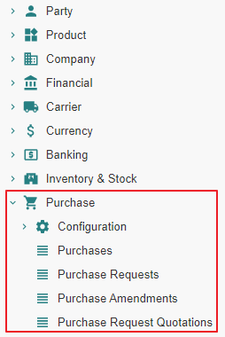
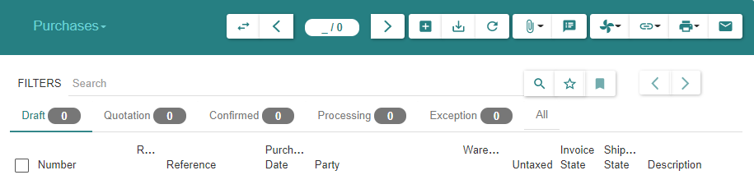
State « Post »

Slide 30
Purchase Configuration

Slide 31
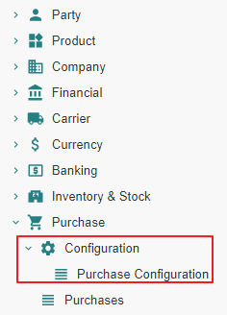
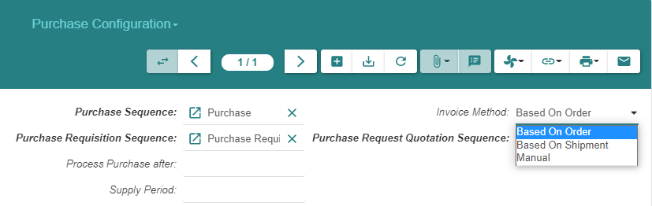
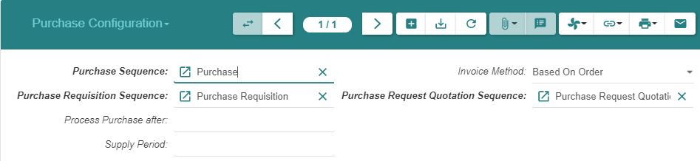
Purchase Configuration (1/2)
Note : The configuration for « Drop Shipment Sequence » will be available later once we activate the « Sale » modules

Slide 32
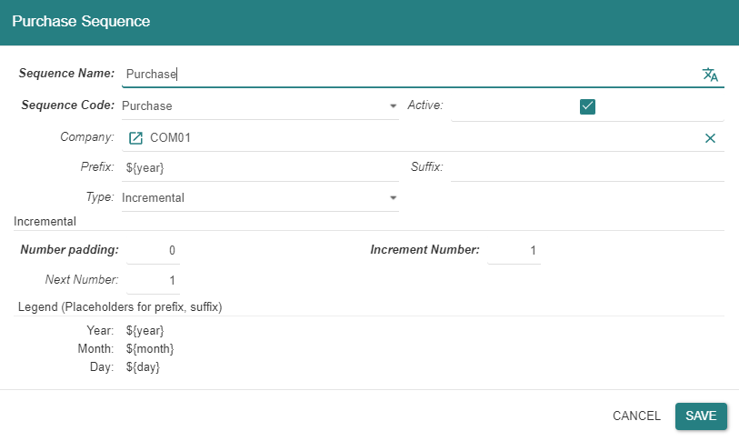
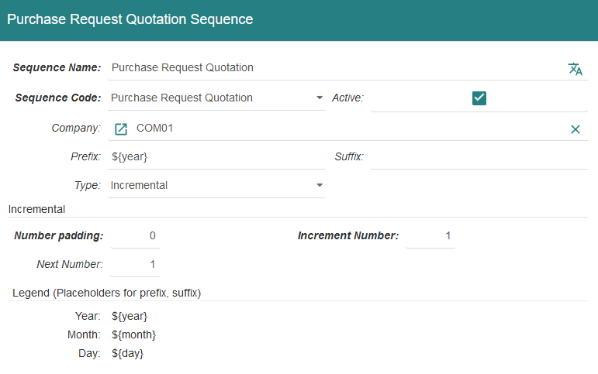
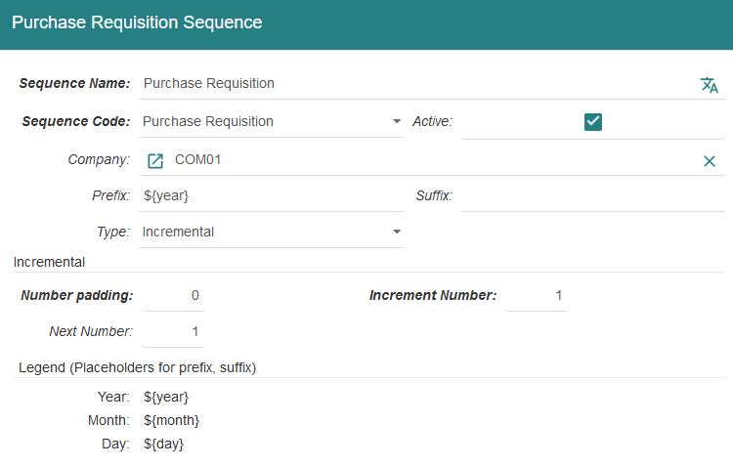
Purchase Configuration (2/2)

Slide 33
Purchase - State Changes - Impact Analysis Model

Slide 34
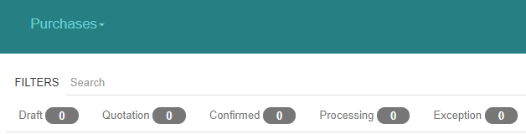
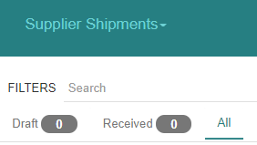
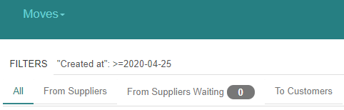
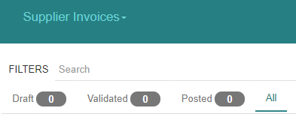
« Purchase » related states

Slide 35
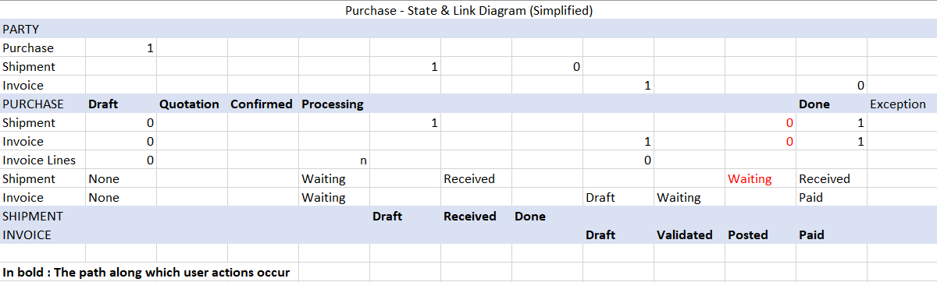
The basic State Diagram for « Purchases »
The diagram does not display the action that triggers the state transition
In red : possible error

Slide 36
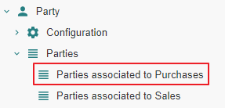
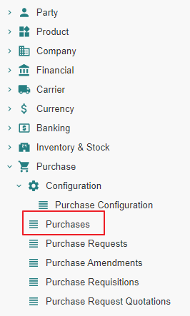
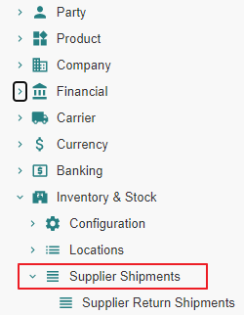
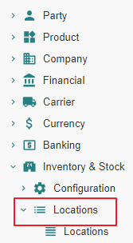
Impact analysis

Slide 37
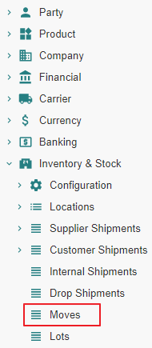
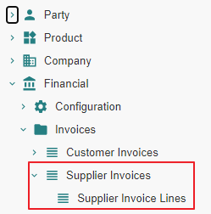
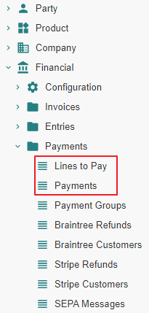
Impact analysis

Slide 38

Impact analysis

Slide 39




Impact analysis

Slide 40
Supplier Purchase - State Changes - Impact Analysis

Slide 41
Purchase From State « Nill » to State « Draft »

Slide 42
Purchase From State « Nill » to State « Draft » Action

Slide 43


Purchase
Purchases are not numbered whilst they are in state « Draft »

Slide 44
Purchase From State « Nill » to State « Draft » Impact

Slide 45
Purchase - From « Nill » To « Draft »
 |  | State | Created - Updated - Deleted -Linked
Supplier
Parties associated to Purchases | 1 |  | Linked to Purchase
Purchase
Purchases (Supplier) | 2 | Draft | Created
Shipment
Supplier Shipments (Supplier) | 3
Stock
Stock Locations | 4
Stock Moves | 5
Invoice
Invoices (Supplier) | 6
Invoice Lines | 7
Payment
Lines to Pay | 8
Payments | 9

Slide 46
Purchase - From « Nill » To « Draft »
 |  | State | Created - Updated - Deleted -Linked
Accounting
Journals - Periods | 10
Account Moves | 11
Open Journal | 12
General Ledger | 13
Balance Sheet | 14
Income Statement | 15
General Journal | 16

Slide 47


1 - Parties associated to Purchases
We can navigate to « Purchases », « Shipments » or « Invoices » from here on or from Menu Items

Slide 48


2 - Purchases | Purchases (SUP01)

Slide 49

10 - Journals - Periods

Slide 50

11 - Account Moves
An « Account Move Line » is created in « State-Draft ». It impacts the General Ledger, the Balance Sheet », the Income Statement, the (Specific, e.g. Expense) Journal, the General Journal.

Slide 51


12 - Open Journal
When an « Account Move Line » is created on a given « Journal » (e.g. « EXP »), it impacts the General Ledger, the Balance Sheet », the Income Statement, the (Specific, e.g. Expense) Journal, the General Journal.

Slide 52

13 - General Ledger

Slide 53

14 - Balance Sheet

Slide 54

15 - Income statement

Slide 55

16 - General Journal

Slide 56
Purchase From State « Draft » to State « Quotation »

Slide 57
Purchase From State « Draft » to State « Quotation » Action

Slide 58


Purchase
Purchases are numbered when they reach state « Quotation »
Purchases can be returned to state « Draft », e.g. when the price has been renegociated with the « Supplier »

Slide 59
Purchase From State « Draft » to State « Quotation » Impact

Slide 60
Purchase - From « Draft » To « Quotation »
 |  | State | Created - Updated - Deleted -Linked
Supplier
Parties associated to Purchases | 1 |  | Linked to Purchase
Purchase
Purchases (Supplier) | 2 | Quotation | Updated
Shipment
Supplier Shipments (Supplier) | 3
Stock
Stock Locations | 4
Stock Moves | 5
Invoice
Invoices (Supplier) | 6
Invoice Lines | 7
Payment
Lines to Pay | 8
Payments | 9

Slide 61
Purchase - From « Draft » To « Quotation »
 |  | State | Created - Updated - Deleted -Linked
Accounting
Journals - Periods | 10
Account Moves | 11
Open Journal | 12
General Ledger | 13
Balance Sheet | 14
Income Statement | 15
General Journal | 16

Slide 62
1 - Parties associated to Purchases
We can navigate to « Purchases », « Shipments » or « Invoices » from here on or from Menu Items

Slide 63


2 - Purchases | Purchases (SUP01)

Slide 64
Purchase From State « Quotation » to State « Confirmed » or From State « Quotation » to State « Processing »

Slide 65
State transitions
Upon « Confirm » action by the user, a « Sale » or « Purchase » evolves from state « Quotation » to :
State « Confirmed » when a latent purchase processing error condition exists
State « Processing » when such error does not exist.
In the present scenario, the error condition consists in the « Product » not being linked to an « Account Category » and the state transition is from « Quotation » to « Confirmed »
Confirmed
Confirm
-
Purchase Processing related Error Condition Exists
Confirm
-
Purchase Processing related Error Condition Resolved
Confirm
-
Purchase Processing possible
Confirm
Quotation
Processing

Slide 66
Purchase From State « Quotation » to State «Confirmed »

Slide 67
Purchase From State « Quotation » to State «Confirmed » Action

Slide 68

Purchase

Slide 69
Purchase From State « Quotation » to State «Confirmed » Impact

Slide 70
Purchase - From « Quotation » To « Confirmed »
 |  | State | Created - Updated - Deleted -Linked
Supplier
Parties associated to Purchases | 1 |  | Linked to Purchase
Purchase
Purchases (Supplier) | 2 | Confirmed | Updated
Shipment
Supplier Shipments (Supplier) | 3
Stock
Stock Locations | 4
Stock Moves | 5
Invoice
Invoices (Supplier) | 6
Invoice Lines | 7
Payment
Lines to Pay | 8
Payments | 9

Slide 71
Purchase - From « Quotation » To « Confirmed »
 |  | State | Created - Updated - Deleted -Linked
Accounting
Journals - Periods | 10
Account Moves | 11
Open Journal | 12
General Ledger | 13
Balance Sheet | 14
Income Statement | 15
General Journal | 16

Slide 72


2 - Purchases | Purchases (SUP01)

Slide 73
Purchase From State « Confirmed » to State «Processing » Action

Slide 74


Purchase
The button “Process” checks that the purchase order is in a correct state with respect to forthcoming shipment, invoicing and accounting treatment.
In our example, an “Account Category” is missing on the “Product PROD01”

Slide 75


Purchase

Slide 76

Purchase

Slide 77
Purchase From State « Confirmed » to State «Processing » Impact

Slide 78
Purchase - From « Confirmed » To « Processing »
 |  | State | Created - Updated - Deleted -Linked
Supplier
Parties associated to Purchases | 1 |  | Linked to Purchase
Purchase
Purchases (Supplier) | 2 | Processing | Updated
Shipment
Supplier Shipments (Supplier) | 3
Stock
Stock Locations | 4
Stock Moves | 5 | Draft | Created [Supplier to Input Zone]
Invoice
Invoices (Supplier) | 6
Invoice Lines | 7 |  | Created [Linked to Purchase Line]
Payment
Lines to Pay | 8
Payments | 9

Slide 79
Purchase - From « Confirmed » To « Processing »
 |  | State | Created - Updated - Deleted -Linked
Accounting
Journals - Periods | 10
Account Moves | 11
Open Journal | 12
General Ledger | 13
Balance Sheet | 14
Income Statement | 15
General Journal | 16

Slide 80


2 - Purchases | Purchases (SUP01)

Slide 81


5 - Stock Moves

Slide 82


7 - Invoice Lines

Slide 83
Supplier Shipment - State Changes - Actual States

Slide 84
Motivation
It is certainly possible to process the shipment(s) pertaining to a « Purchase » using the « Move » menu item.
However, it is recommended to proceed using the « Supplier Shipment » functionality which will manage the following stock moves in a coherent fashion :
« Incoming Moves » between the supplier location and the warehouse input location
« Storage Moves » between the warehouse input location and the warehouse storage location

Slide 85
Supplier Shipment « Nill » To « Draft »

Slide 86
Supplier Shipment From « Nill » To « Draft » Action

Slide 87

Supplier Shipments – Incoming Moves - Using « Added » or « Created »

Slide 88


Supplier Shipments – Incoming Moves - Using « Added »

Slide 89

Supplier Shipments – Incoming Moves - Using « Created » (1/2)

Slide 90


Supplier Shipments – Incoming Moves - Using « Created » (2/2)
Using « Created », it is possible to fine tune « Product », « Quantity », « Unit Price »

Slide 91

Supplier Shipments – Inventory Moves

Slide 92
Supplier Shipment From « Nill » To « Draft » Impact

Slide 93
Supplier Shipment - From « Nill » To « Draft »
 |  | State | Created - Updated - Deleted -Linked
Supplier
Parties associated to Purchases | 1 |  | Linked to Purchase ; Linked to Shipment
Purchase
Purchases (Supplier) | 2 | Processing | Updated ; Linked to Shipment
Shipment
Supplier Shipments (Supplier) | 3 | Draft | Created
Stock
Stock Locations | 4
Stock Moves | 5 | Draft | Created [Supplier to Input Zone]
Invoice
Invoices (Supplier) | 6
Invoice Lines | 7 |  | Created [Linked to Purchase Line]
Payment
Lines to Pay | 8
Payments | 9

Slide 94
Supplier Shipment - From « Nill » To « Draft »
 |  | State | Created - Updated - Deleted -Linked
Accounting
Journals - Periods | 10
Account Moves | 11
Open Journal | 12
General Ledger | 13
Balance Sheet | 14
Income Statement | 15
General Journal | 16

Slide 95

1 Parties associated to Purchases

Slide 96

2 - Purchases | Purchases (SUP01)

Slide 97


3 - Supplier Shipments | Supplier Shipments (SUP01)

Slide 98

5 - Stock Moves

Slide 99
Supplier Shipment « Draft » To « Received »

Slide 100
Supplier Shipment From « Draft » To « Received » Action

Slide 101

Supplier Shipments - Incoming Moves

Slide 102

Supplier Shipments - Inventory Moves

Slide 103
Supplier Shipment From « Draft » To « Received » Impact

Slide 104
Supplier Shipment - From « Draft » To « Received »
 |  | State | Created - Updated - Deleted -Linked
Supplier
Parties associated to Purchases | 1 |  | Linked to Purchase ; Linked to Shipment
Purchase
Purchases (Supplier) | 2 | Processing | Updated ; Linked to Shipment
Shipment
Supplier Shipments (Supplier) | 3 | Received | Updated
Stock
Stock Locations | 4 |  | Updated [Supplier -= Move ; Input Zone += Move]
Stock Moves | 5 | Done [Supplier to Input] ; Draft [Input to Storage] | Updated [Supplier to Input] ; Created [Input to Storage]
Invoice
Invoices (Supplier) | 6
Invoice Lines | 7 |  | Created [Linked to Purchase Line]
Payment
Lines to Pay | 8
Payments | 9

Slide 105
Supplier Shipment - From « Draft » To « Received »
 |  | State | Created - Updated - Deleted -Linked
Accounting
Journals - Periods | 10
Account Moves | 11
Open Journal | 12
General Ledger | 13
Balance Sheet | 14
Income Statement | 15
General Journal | 16

Slide 106


2 - Purchases | Purchases (SUP01)

Slide 107



3 - Supplier Shipments | Supplier Shipments (SUP01)

Slide 108


4 - Stock Locations

Slide 109


4 - Stock Locations

Slide 110



5 - Stock Moves

Slide 111
Supplier Shipment From « Received » to « Done »

Slide 112
Supplier Shipment From « Received » To « Done » Action

Slide 113

Supplier Shipments

Slide 114

Supplier Shipments

Slide 115
Supplier Shipment From « Received » To « Done » Impact

Slide 116
Supplier Shipment - From « Received » To « Done »
 |  | State | Created - Updated - Deleted -Linked
Supplier
Parties associated to Purchases | 1 | Updated | Linked to Purchase
Purchase
Purchases (Supplier) | 2 | Processing | Updated ; Linked to Shipment
Shipment
Supplier Shipments (Supplier) | 3 | Done | Updated
Stock
Stock Locations | 4 |  | Updated [Input -= Move ; Storage += Move]
Stock Moves | 5 | Done [Input to Storage] | Updated [Input to Storage]
Invoice
Invoices (Supplier) | 6
Invoice Lines | 7 |  | Created [Linked to Purchase Line]
Payment
Lines to Pay | 8
Payments | 9

Slide 117
Supplier Shipment - From « Received » To « Done »
 |  | State | Created - Updated - Deleted -Linked
Accounting
Journals - Periods | 10
Account Moves | 11
Open Journal | 12
General Ledger | 13
Balance Sheet | 14
Income Statement | 15
General Journal | 16

Slide 118

1 - Parties associated to Purchases

Slide 119


2 - Purchases | Purchases (SUP01)
Note : The « Shipment » information appears to be different depending on the linked-by entity :
From the viewpoint « Supplier », there is no « Shipment » linked-to anymore
From the viewpoint « Purchase » there is still a « Shipment » linked-to

Slide 120



3 - Supplier Shipments | Supplier Shipments (SUP01)

Slide 121
4 - Stock Locations

Slide 122

4 - Stock Locations

Slide 123


4 - Stock Locations

Slide 124

5 - Stock Moves

Slide 125
Supplier Invoice - State Changes - Actual States

Slide 126
Supplier Invoices From State « Nill » to State « Draft »

Slide 127
Supplier Invoices From State « Nill » to State « Draft » Action

Slide 128


Supplier Invoices (1/2)

Slide 129

Supplier Invoices (2/2)

Slide 130

Supplier Invoice Lines
« Supplier Invoice Lines » are referenced to help build the « Supplier Invoice »

Slide 131
Supplier Invoices From State « Nill » to State « Draft » Impact

Slide 132
Supplier Invoices - From « Nill » To « Draft »
 |  | State | Created - Updated - Deleted -Linked
Supplier
Parties associated to Purchases | 1 | Updated | Linked to Purchase
Purchase
Purchases (Supplier) | 2 | Processing | Updated ; Linked to Shipment ; Linked to Invoice
Shipment
Supplier Shipments (Supplier) | 3 | Done | Updated
Stock
Stock Locations | 4 |  | Updated [Input -= Move ; Storage += Move]
Stock Moves | 5 | Done [Input to Storage] | Updated [Input to Storage]
Invoice
Invoices (Supplier) | 6 | Draft | Created ; Linked to Invoice Line
Invoice Lines | 7 |  | Linked to Invoice [Linked to Purchase Line]
Payment
Lines to Pay | 8
Payments | 9

Slide 133
Supplier Invoices - From « Nill » To « Draft »
 |  | State | Created - Updated - Deleted -Linked
Accounting
Journals - Periods | 10
Account Moves | 11
Open Journal | 12
General Ledger | 13
Balance Sheet | 14
Income Statement | 15
General Journal | 16

Slide 134

1 - Parties associated to Purchases

Slide 135


2 - Purchases | Purchases (SUP01)

Slide 136

6 - Invoices | Invoices (SUP01)

Slide 137

7 - Invoice Lines

Slide 138
Supplier Invoices From State « Draft » to State « Validated »

Slide 139
Supplier Invoices From State « Draft » to State « Validated » Action

Slide 140

Supplier Invoices (1/2)

Slide 141

Supplier Invoices (2/2)

Slide 142
Supplier Invoices From State « Draft » to State « Validated » Impact

Slide 143
Supplier Invoices - From « Draft » To « Validated »
 |  | State | Created - Updated - Deleted -Linked
Supplier
Parties associated to Purchases | 1 | Updated | Linked to Purchase ; Updated [Payable = -6]
Purchase
Purchases (Supplier) | 2 | Processing | Updated ; Linked to Shipment ; Linked to Invoice
Shipment
Supplier Shipments (Supplier) | 3 | Done | Updated
Stock
Stock Locations | 4 |  | Updated [Input -= Move ; Storage += Move]
Stock Moves | 5 | Done [Input to Storage] | Updated [Input to Storage]
Invoice
Invoices (Supplier) | 6 | Validated | Created ; Linked to Invoice Line ; Linked to Lines to pay ; Payable amount set
Invoice Lines | 7 |  | Linked to Invoice [Linked to Purchase Line]
Payment
Lines to Pay | 8 |  | Not Visible whereas visible as part of Invoice and Accounting Journal (?)
Payments | 9

Slide 144
Supplier Invoices - From « Draft » To « Validated »
 |  | State | Created - Updated - Deleted -Linked
Accounting
Journals - Periods | 10 | Draft [Account Move Lines] | Created [Account Move Lines : 6011 - 4011]
Account Moves | 11 | Draft [Account Move Lines] | Created [Account Move Lines : 6011 - 4011]
Open Journal | 12 | Draft [Account Move Lines] | Created [Account Move Lines : 6011 - 4011] ; Journal « Expense » for Period 1st Quarter
General Ledger | 13 |  | Updated [Accounts 6011 & 4011]
Balance Sheet | 14 |  | Updated [Accounts 6011 & 4011]
Income Statement | 15 |  | Updated [Accounts 6011]
General Journal | 16 | Draft [Account Move Lines] | Created [Account Move Lines : 6011 - 4011]

Slide 145


1 - Parties associated to Purchases

Slide 146


2 - Purchases | Purchases (SUP01)

Slide 147
6 - Invoices | Invoices (SUP01) (1/2)

Slide 148
6 - Invoices | Invoices (SUP01) (2/2)

Slide 149
7 - Invoice Lines

Slide 150

8 - Lines to Pay

Slide 151


10 - Journals - Periods

Slide 152


11 - Account Moves

Slide 153

12 - Open Journal

Slide 154

13 - General Ledger

Slide 155

14 - Balance Sheet

Slide 156

14 - Balance Sheet

Slide 157

15 - Income statement

Slide 158

16 - General Journal

Slide 159
Supplier Invoices From State « Validated » to State « Posted »

Slide 160

Motivation

Slide 161
Supplier Invoices From State « Validated » to State « Posted » Action

Slide 162

Supplier Invoices (1/2)
Notice that the « Post » operation could have been performed on the « Account Move » screen

Slide 163

Supplier Invoices (2/2)

Slide 164
Supplier Invoices From State « Validated » to State « Posted » Impact

Slide 165
Supplier Invoices - From « Validated » To « Posted »
 |  | State | Created - Updated - Deleted -Linked
Supplier
Parties associated to Purchases | 1 | Updated | Linked to Purchase
Purchase
Purchases (Supplier) | 2 | Processing | Updated ; Linked to Shipment ; Linked to Invoice
Shipment
Supplier Shipments (Supplier) | 3 | Done | Updated
Stock
Stock Locations | 4 |  | Updated [Input -= Move ; Storage += Move]
Stock Moves | 5 | Done [Input to Storage] | Updated [Input to Storage]
Invoice
Invoices (Supplier) | 6 | Posted | Created ; Linked to Invoice Line ; Linked to Lines to pay ; Payable amount set
Invoice Lines | 7 |  | Linked to Invoice [Linked to Purchase Line]
Payment
Lines to Pay | 8 |  | Not Visible whereas visible as part of Invoice and Accounting Journal (?)
Payments | 9

Slide 166
Supplier Invoices - From « Validated » To « Posted »
 |  | State | Created - Updated - Deleted -Linked
Accounting
Journals - Periods | 10 | Posted [Account Move Lines] | Created [Account Move Lines : 6011 - 4011]
Account Moves | 11 | Posted [Account Move Lines] | Created [Account Move Lines : 6011 - 4011]
Open Journal | 12 | Posted [Account Move Lines] | Created [Account Move Lines : 6011 - 4011] ; Journal « Expense » for Q1
General Ledger | 13 |  | Updated [Accounts 6011 & 4011]
Balance Sheet | 14 |  | Updated [Accounts 4011]
Income Statement | 15 |  | Updated [Accounts 6011]
General Journal | 16 | Draft [Account Move Lines] | Created [Account Move Lines : 6011 - 4011]

Slide 167


2 - Purchases | Purchases (SUP01)
Notice that the following states went from :
Invoice : « Waiting » (1) to « Waiting » (0)
Shipment : « Received » (1) to « Waiting » (0)

Slide 168
6 - Invoices | Invoices (SUP01) (1/2)
Notice that the « Post » operation could have been performed on the « Account Move » screen

Slide 169
6 - Invoices | Invoices (SUP01) (2/2)

Slide 170
7 - Invoice Lines

Slide 171

8 - Lines to Pay

Slide 172

10 - Journals - Periods

Slide 173


11 - Account Moves

Slide 174

12 - Open Journal

Slide 175
Supplier Payment - State Changes - Actual States

Slide 176
Payment

Slide 177
Payment Precondition

Slide 178




Invoice Payment Method

Slide 179
Payment Action

Slide 180



Supplier Invoice

Slide 181

Supplier Invoice

Slide 182
Payment Impact

Slide 183
Payment
 |  | State | Created - Updated - Deleted -Linked
Supplier
Parties associated to Purchases | 1 | Updated | Linked to Purchase ; Updated [Payable = 0]
Purchase
Purchases (Supplier) | 2 | Processing | Updated ; Linked to Shipment ; Linked to Invoice
Shipment
Supplier Shipments (Supplier) | 3 | Done | Updated
Stock
Stock Locations | 4 |  | Updated [Input -= Move ; Storage += Move]
Stock Moves | 5 | Done [Input to Storage] | Updated [Input to Storage]
Invoice
Invoices (Supplier) | 6 | Paid | Created ; Linked to Invoice Line ; Linked to Lines to pay ; Payable amount set
Invoice Lines | 7 |  | Linked to Invoice [Linked to Purchase Line]
Payment
Lines to Pay | 8
Payments | 9

Slide 184
Payment
 |  | State | Created - Updated - Deleted -Linked
Accounting
Journals - Periods | 10 | Posted [Account Move Lines] | Created [Account Move Lines : 6011 - 4011] ; [Account Move Lines : 5311 - 4011]
Account Moves | 11 | Posted [Account Move Lines] | Created [Account Move Lines : 6011 - 4011] ; [Account Move Lines : 5311 - 4011]
Open Journal | 12 | Posted [Account Move Lines] | Created [Account Move Lines : 6011 - 4011] ; Journal « Expense » for Q1 Created [Account Move Lines : 5311 - 4011] ; Journal « Cash » for Q1
General Ledger | 13 |  | Updated [Accounts 6011 & 4011] ; Created [Move Lines : 5311 - 4011]
Balance Sheet | 14 |  | Updated [Accounts 4011] ; [Account Move Lines : 5311 - 4011]
Income Statement | 15 |  | Updated [Accounts 6011]
General Journal | 16 | Posted [Account Move Lines] | Created [Account Move Lines : 6011 - 4011] ; [Account Move Lines : 5311 - 4011]

Slide 185


1 - Parties associated to Purchases

Slide 186


2 - Purchases | Purchases (SUP01)

Slide 187

6 - Invoices | Invoices (SUP01) (1/2)

Slide 188

6 - Invoices | Invoices (SUP01) (2/2)

Slide 189
7 - Invoice Lines

Slide 190
8 - Lines to Pay

Slide 191

9 - Payments
Notice that there are no « Payments » registered

Slide 192



10 - Journals - Periods

Slide 193


11 - Account Moves

Slide 194

11 - Account Moves

Slide 195


12 - Open Journal

Slide 196


12 - Open Journal

Slide 197

13 - General Ledger

Slide 198

14 - Balance Sheet

Slide 199

14 - Balance Sheet

Slide 200


16 - General Journal

